Slide 1
Project Management Transformation Utilizing Scrum
Ottawa Cloud Consulting Inc.

Slide 2
Typical Project Process
New Idea
Informal Request
Manager told in person
Manager tells team in person
Team works on project
Project is "Done"
Rework to fix bugs / missing features
Rework to fix bugs / missing features
Project is "Done"
Project is "Done"
Rework to fix bugs / missing features
Project is "Done"
Notes:
We start by looking at the current ‘actual’ process used for work.
Typically, this involves a number of cycles on the same work to capture errors and omissions for the deliverable

Slide 3
Unstructured Process
Request for work
????
????
Work Done
Rework
Requirements not defined
Acceptance and Success criteria not defined
Work tasks not or badly defined
QA/Testing Process not defined and planned
Notes:
Whilst we may think there is a well structured process, there is usually a gap between the initial request for the work, and the completion of the work that has a large number of unknown actions.
These unknowns are usually from:
Requirements not defined
Acceptance and Success criteria not defined
Work tasks not or badly defined
QA/Testing Process not defined and planned

Slide 4
First Iteration – Capture Data And Create Basic Structure

Slide 5
Iteration 1 – Implement JIRA
We implement JIRA with a “version 1.0” mentality, as we know that various unknowns will require us to make changes to the system and processes
Capturing data within JIRA allows us to identify the unknown variables and perform simple gap analysis
Creating JIRA workflows allows us to identify the workflows that the team currently takes and perform simple gap analysis
As the quantity of unknown and undefined variables are identified we make decisions to identify and resolve these
Notes:
The concept here, is that our first iteration is to find a good implementation and start to identify good workflows and requirements, predominantly from ‘lessons learned’
As we learn more about how we work, we are in a better position to decide what is a practice to keep, a practice to stop, and issues to start to address

Slide 6


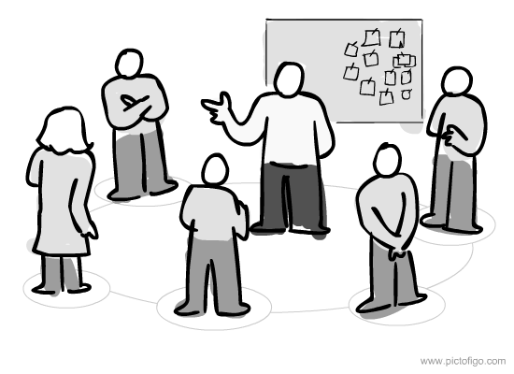
Iteration 1 - Goals
Implement JIRA
Capture work
Capture process
Implement Kanban
Visualize workload
Visualize process
Implement Daily Stand-ups
Capture progress
Capture blocker issues
Notes:
Iteration 1 goals are all about understanding, and introducing collaborative communication
We identify the implementation action > what it does > what value it adds

Slide 7
Iteration 1 – Gap Analysis
Map "As Is" Process
Identify End State Process
Comparison
Recommendation
Implementation
Notes:
Using gap analysis for continual improvement

Slide 8
Iteration 1 - Visualized Workload Kanban
To Do
Task 1
Task 2
In Progress
Task 1
Done
Task 1
Task 2
Task 3
Task 4
Task 5
Task 6
Task 7
Task 8
Task 9
Task 11
Task 12
Task 2
Task 3
Task 4
Task 5
Task 6
Task 7
Task 8
Task 9
Task 10
Task 11
Task 12
Task 13
Task 14
Task 15
Task 16
Task 17
Task 18
Task 3
Task 4
Notes:
As iteration 1 only focuses on creating visibility and understanding, we expect to be able to see and realize our pain points:
The majority of items are ”In Progress” because once they are written, there are assumptions that they are being worked on. Meetings, emails, standups may also cause confusion when we ask a developer about a status of something they have not started, and they mis-understand that they should begin working on it too so they can look good in standup. Without previous visualizations, we also do not have good grasp on what is to be done today vs tomorrow vs next week vs next month vs next quarter, etc.s
We realise that we are very busy ‘doing stuff’ but very little ‘tangible deliverables’ slides over to the Done column
Our To-Do column is smaller than our In-Progress column, showing that we are maybe not planning far enough ahead, not breaking down bigger tasks into smaller achievable deliverables, mis-understanding effort and timelines, or just throwing everything at the team to get completed.

Slide 9
Iteration 1 - Visualised Workflow
Request
In Progress
Done
To Do
Assumed Process Workflow
Actual Process Workflow
Request
To Do
Gather Requirements
In Progress
Missing Requirements
In Progress
In Review
In Testing
Review QA Findings
In Progress (Re-Work)
In Testing
QA Approved
Ready for Release
Deployed
Notes:
We start to visualize, by tasks either moving back and forth from ‘in-progress’ to ‘done’ and back to ‘in-progress’ or by standups involving developers saying they are done, when the tasks are not actually ‘delivered’

Slide 10
Second Iteration – Manageable Workloads and Workflows

Slide 11


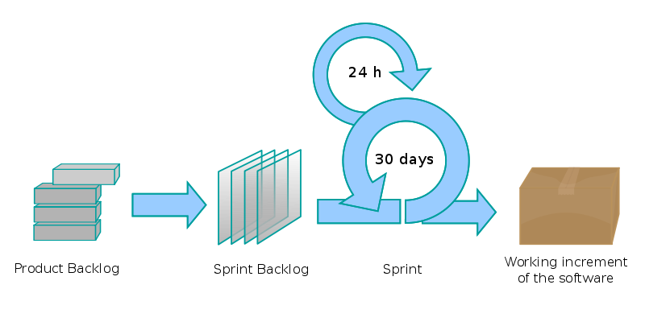
Iteration 2 - Goals
Implement Backlog
Separate Future Work
Focus Work-In-Progress
Implement Sprints
Show Current Period
Plan Future Period
Manage Work-In-Progress
Define Achievable Tasks
Identify Requirements
Notes:
Our second iteration is designed to manage workflow, by creating logic gates.
Backlog stores the work scheduled for ‘later’
Sprints capture the work cycles for planning in ‘bunches’ of time and tasks
We manage Work-In-Progress by defining Achievable tasks that can be delivered within a sprint

Slide 12
Iteration 2 – Time-Boxing and Backlog
Backlog
P1 - New Task
P2 - New Task
P3 - New Task
P4 - New Task
- Undefined Task
- Undefined Task
- Undefined Task
- Undefined Task
- Undefined Task
Period 1
Achievable Work
Period 2
Period 3
Achievable Work
Achievable Work
Notes:
Sprints break down the work into small achievable chunks, bound by time boxes of a standard size.
This standardizes the:
Dates for start/finish
Effort available in days
Reporting periods

Slide 13
Iteration 2 – Time-Boxing With Sprints
Sprint 1 Weeks 1 & 2
Achievable Tasks
Sprint 2 Weeks 3 & 4
Achievable Tasks
Sprint 3 Weeks 5 & 6
Achievable Tasks
Defined Deliverables
Defined Deliverables
Defined Deliverables
Notes:
Example with two week sprints

Slide 14
Iteration 2 –Kanban and/or Sprint Boards
Backlog
Task 1
Task 2
In Progress
Task 1
Done
Task 1
Task 2
Task 3
Task 4
Task 5
Task 6
Task 7
Task 8
Task 9
Task 11
Task 12
Task 2
Task 3
Task 4
Task 5
Task 3
Task 4
Planned Not Started
Task 1
Task 2
Task 3
Task 4
Task 5
Task 5
Task 6
Task 7
Task 6
Task 7
Task 8
Task 9
Task 10
Notes:
We still visualize with Kanbans, even if we use ‘Sprint Boards’
In-Progress shrinks considerably to match available developer time
Done tasks grow in volume
Planned Not-Started acts as a conceptual stage for ‘items that are ready to work on’ but not in the active sprint,
Backlog becomes better managed

Slide 15
Iteration 2 - Backlog Management
Define Requirements for Work
Obtain Requirements
Define Work Types and Steps
Create JIRA Tasks
Define Priorities
Up Rank and Down Rank Tasks
Plan Workload
Define Dependencies
Resolve Blocking Issues
Estimate and Allocate Resource
Backlog
P1 - New Task
P2 - New Task
P3 - New Task
P4 - New Task
- Undefined Task
- Undefined Task
- Undefined Task
- Undefined Task
- Undefined Task
Notes:
We define requirements and dependencies that our tasks need to have and resolve those while they are in the backlog.
This keeps the Sprint work clean, and a task in a sprint can be worked on to completion from Day 1.
Different Work “Types” can be created within the system if needed
We introduce priorities at the Backlog stage, so that work can be up-ranked and down-ranked before it gets put in front of a developer in a Sprint
Estimation of work happens in the backlog, so that we can assign the right volume of work for a sprint to be achievable and deliverable

Slide 16
Third Iteration – On-Going Cadences and Structure

Slide 17


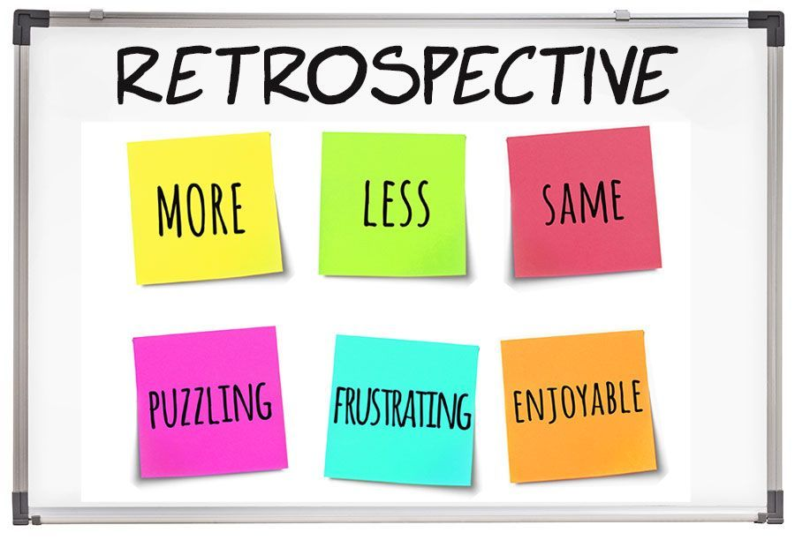
Iteration 3 - Goals
Defining Definitions
Define Deliverables
Define Dependencies
Backlog Grooming
Plan Future Workloads
Prioritize With Business Requirements
Sprint Retrospectives
Identify Good and Bad Processes
Trial and Implement New Processes
Notes:
Our 3rd iteration overlaps with previous iterations for concepts, but as an a Continuous Improvement step. Here we improve on what he have built already

Slide 18
Iteration 3 – Backlog Grooming
Define Work
Acceptance Criteria
Definition of Done
Estimating
Complexity of Work
Resource Ability and Capacity
Prioritization
Deliverable Dates
Competing Workloads
Definition of Ready
Level of Effort
Achievable Time Frames
Notes:
Backlog Grooming is defined as its own item now, moving out from just being a basic process of managing backlog.
Here we set aside specific time to review tasks in the backlog, with greater focus.
We introduce specific concepts:
Acceptance Criteria – How we know it works
Definition of Done – Agreeing between us what ‘done’ actually means
Definition of Ready – Understanding pre-reqs that stop us working on a task
Complexity – How complexity affects expectations, and can make planning/effort/estimation unreliable

Slide 19
Iteration 3 – Defining Work Statements
Acceptance Criteria
Defining Acceptance Criteria ensures that the correct work is completed for the task
Ensures the minimum features are created, and pushes additional features out of scope
Definition of Done
The Definition of Done ensures everyone on the Team knows exactly what is expected of everything the Team delivers
Standardizes vernacular, and ensures a completed task is completed from a ‘customer’ or release perspective
Definition of Ready
Having a Definition of Ready means that tasks must be immediately actionable
Identify requirements, and dependencies and ensure all resources are available for work
Notes:
Summary of of Defining Work Statements.
These can frequently be made into checklists for work items

Slide 20
Iteration 3 – Estimating Work
Complexity of work
Resource ability & capacity
Level of Effort
Easy / Average / Hard / Impossible
Dedicated Focus / Partial Focus / No Resource
Estimated number of hours/days
Notes:
We understand and define what work can be completed in a sprint based on factors of difficulty and availabiltiy.

Slide 21
Iteration 3 – Prioritization of Work
Up Rank
Near Deliverable Date
Down Rank
Far Off Deliverable Date
Higher Comparative Importance
Small and Easy Tasks
High Benefit
Lower Comparative Importance
Resources Not Available
Low Benefit
Notes:
We define better rules for prioritization, moving away from “I think” statements or “Management wants” drivers.

Slide 22
Iteration 3 – Who Is Involved
Backlog Grooming and Planning
Doers of Work
Planners of Work
Management
External Influencers
‘Doers of Work’ explain the LoE and Task Requirements
‘External Influencers’ can influence priorities and complexities
‘External Influencers’ can answer questions
‘Planners of Work’ understand competing priorities
‘Planners of Work’ understand resource availability
‘Management’ need to be aware and can influence priorities
Notes:
For grooming and planning sessions, we start to understand the two key factors:
Who should be involved
Why they are invovled
This helps us understand their value, impact, and how integrate their needs better

Slide 23
Iteration 3 – Sprint Retrospective
The word “actionable” is significant. Actionable commitments have clear steps to completion and acceptance criteria, just like a good requirement. An actionable commitment is clearly articulated and understood by the team.
When teams first start performing retrospectives, they often find it easier to identify problems than plan what to do about them.
Commitments made in the previous Sprint Retrospective are visited in each new Retrospective. This is necessary for sprint retrospectives to retain their meaning and value.
Although discussion may diverge and converge during the meeting, no Sprint Retrospective is successful if it doesn’t result in commitments by the team. It is not enough to simply reflect on what happened during the Iteration. The Team makes actionable commitments for what it will:
  Keep doing
  Start doing
  Stop doing
What Worked?
What Did Not Work?
Change And Improve
What We Would Like To Do?
Notes:
Summarizing the Sprint Retro

Slide 24
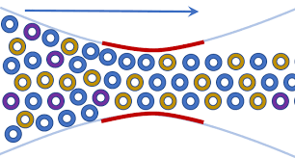
Iteration 3 - The Theory Of Constraints
Theory of constraints is based on the premise that the rate of goal achievement by a goal-oriented system is limited by at least one constraint.
The argument by “reductio ad absurdum” is as follows: If there was nothing preventing a system from achieving higher throughput (i.e., more goal units in a unit of time), its throughput would be infinite — which is impossible in a real-life system.
Only by increasing flow through the constraint can overall throughput be increased.
Assuming the goal of a system has been articulated and its measurements defined, the steps are:
Identify the system's constraint(s).
Decide how to exploit the system's constraint(s).
Subordinate everything else to the above decision(s).
Elevate the system's constraint(s).
Warning! If in the previous steps a constraint has been broken, go back to step 1, but do not allow inertia to cause a system's constraint.
The five focusing steps aim to ensure ongoing improvement efforts are centered on the organization's constraint(s).
Notes:
Whilst the Theory of Constraints is a hugely important concept and value that underlies good project management and planning, it doesn’t have a direct place in our Agile Scrum Transformation.
It is worth understanding, as Scrum should be used as a tool to help understand and manage constraints, in addition to understanding when and why a change in one area may not deliver improvements expected.

Slide 25
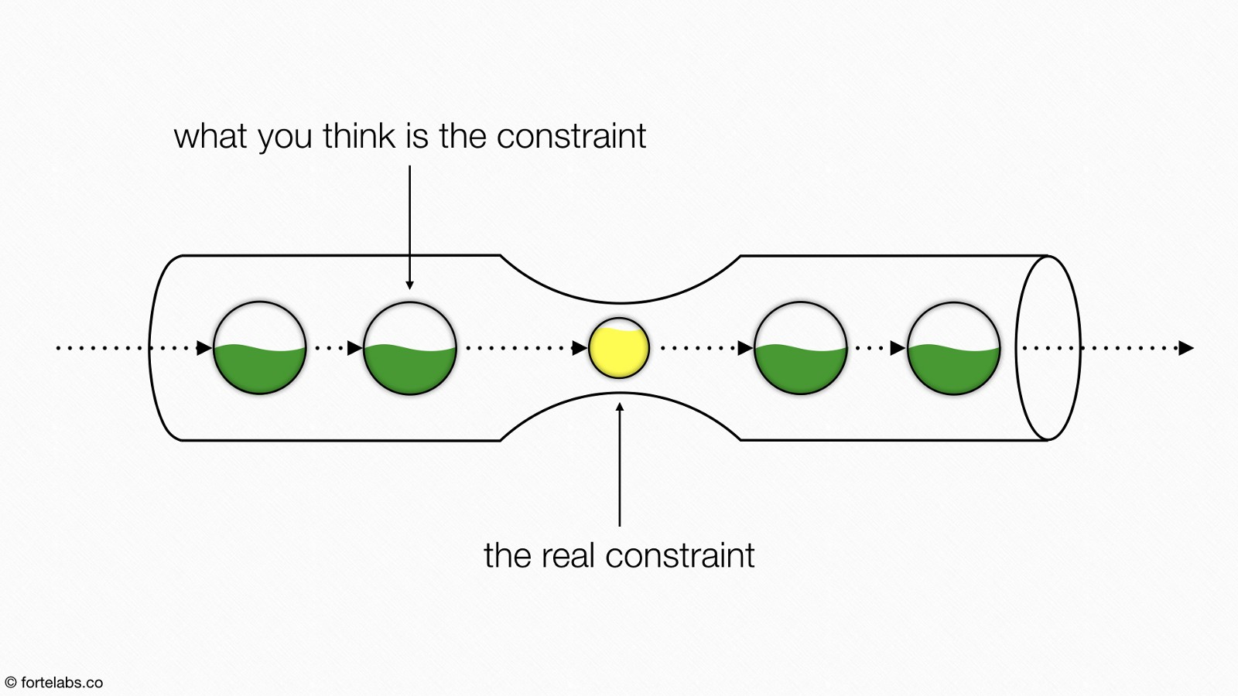
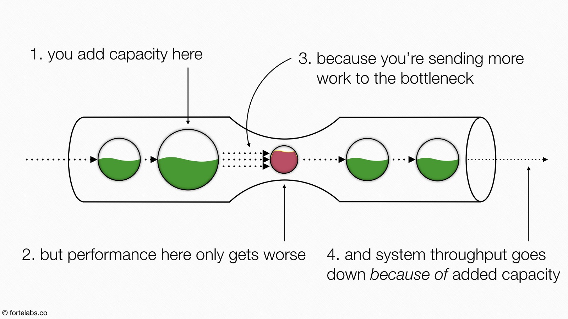
Iteration 3 – Theory of Constraints
Notes:
Adding capacity BEFORE

Slide 26
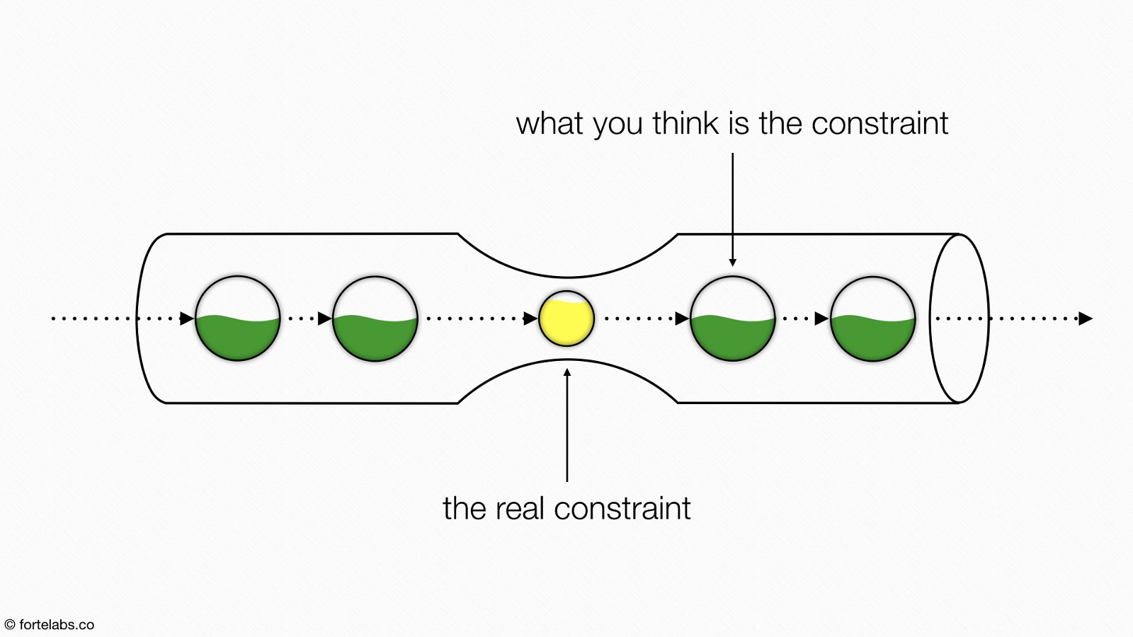
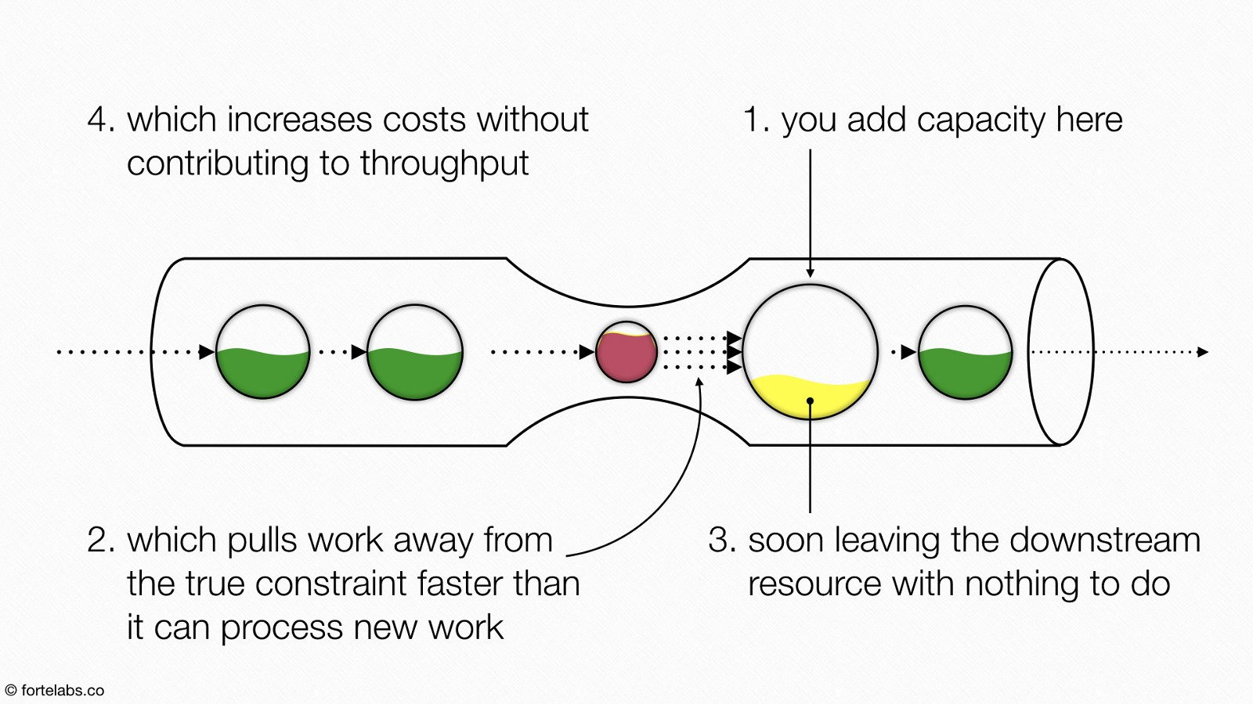
Iteration 3 – Theory of Constraints
Notes:
Adding capactiy AFTER

Slide 27
Fourth Iteration – Better Sprint Management

Slide 28


Iteration 4 - Goals
Sprint Planning
Focused Achievable Deliverables
Understanding Velocity
Planning Ahead
Sprint Planning Into Future Sprints
Continuous Management of Future Sprints
Sprint Review or Demo
Showcase work
Act on feedback
Notes:
Iteration 4 shifts focus to the deliverables of a sprint.
We identify tangible goals for the sprint as a whole, and not just individual tasks
We add Reviews and Demos that help us both work towards a ‘demonstratable product’ and also share with the team for feedback
We can use goals to consolidate future work

Slide 29
Iteration 4 – Sprint Planning
What is Sprint Planning?
Sprint planning is a time-boxed working session that lasts roughly 1 hour for every week of a sprint.
Who does it?
Sprint planning is a collaborative effort involving a Scrum Master, who facilitates the meeting, a Product Owner, who clarifies the details of the product backlog items and their respective acceptance criteria, and the Entire Agile Team, who define the work and effort necessary to meet their sprint commitment.
How do we prepare?
Ensure all sprint candidates meet the team’s Definition of Ready. In the days and weeks leading up to sprint planning, the Product Owner identify the items with the greatest value and works towards getting them to a ready state.
In sprint planning, the entire team agrees to complete a set of product backlog items.
This agreement defines the sprint backlog and is based on the team’s velocity or capacity and the length of the sprint.
Assign a relative story point value
Remove dependencies
Create testable examples
Define acceptance criteria
Meets INVEST criteria
Notes:
Our ‘Sprint Planning’ now becomes its own action and entity. We move away from top-down driven work, to more integrative planning.
We make the Sprint plan a little more flexible, but require higher level of ‘Buy-In’ and formal commitment from development and product teams

Slide 30
Iteration 4 – INVEST Criteria
I
Independent
User stories are the lowest level of functional decomposition. They are expressed in the canonical form of ‘as a <user>, I want some <product feature>, so that I get some <business value>. They are lightweight expressions that remind us to have a future conversation with the business. By writing user stories that are independent, we allow the business to change direction with minimal cost and impact to the emerging product.
N
Negotiable
User stories are not detailed specification. They are not a precise guide for how we are going to build the product, or even what we are going to build. User stories should be high level enough that we can fine-tune both the business implementation and the technical implementation of the requirement. This attribute gives us room to inspect and adapt as we learn about the emerging product.
V
Valuable
User stories are written in the language of the business. They represent an increment of product that can be demonstrated to a potential customer of the system. This attribute can be contrasted with a technical task that might have value, but is irrelevant to the business user of the system. Value has to be in the eye of the business stakeholder.
E
S
Estimate-able
This attribute implies that the team has enough knowledge about how the user story will be developed (and tested) that they can provide a high-level estimate for how long the user story will take to implement. As the user story is about to be pulled into the sprint, the user story must be well known enough that the team can provide a detailed estimate at the task and hour level.
T
Small
You might also express this attribute as ‘sized appropriately’. The idea is that user stories are intended to be small enough that a team can do several within the course of a two-week sprint. Small user stories allow us to test the software and get feedback from our customers early. Early delivery allows us to rapidly reduce the risk that we are building the wrong product or that we are accumulating unnecessary technical debt.
Testability of a user story is defined up-front before we pull the user story into the sprint. This means that we know the conditions of acceptance before we start working on the requirement. We know what it will take to satisfy our customer’s need and how we will verify that those needs have been met.
Testable

Slide 31
Iteration 4 – Sprint Demo
Informal
Demo
Feedback
The Sprint Demo meeting is intentionally kept very informal, typically with rules forbidding the use of PowerPoint slides and focused on simple exhibition.
A Sprint Demo should not become a distraction or significant detour for the team; rather, it should be a natural result of the sprint.
Each sprint is expected to deliver a potentially shippable product increment. This means that at the end of each sprint, the team has produced a coded, tested and usable piece of software. During the Sprint Demo the team shows what they accomplished, and demo any new features.
Participants in the sprint review typically include the product owner, the Scrum team, the Scrum Master, and may include management, customers and developers from other projects.
During the sprint review, the project is assessed against the sprint goal determined during the sprint planning meeting.
Ideally, the team has completed each product backlog item brought into the sprint, and the participants are encouraged to provide feedback, thoughts and ideas.
Notes:
We prohibit PowerPoint because we don’t want ‘concepts’ and ‘future state’ to be referenced, everything should be working demonstratable.
A sprint Demo can be an end-of-sprint activity, or grouped into smaller demos across the sprint as work is completed.
The nature can be very fluid, but a good starting point is to have a Sprint Demo that shows the Sprint Goals being achieved. This starts you off with a good alignment for future practices, and understanding of the value of the Demo.

Slide 32
Iteration 4 – Planning Future Sprints
Even though Scrum does not cover this, positive results can be gained planning Sprints in advance. Benefits include:
Anticipate problems that require immediate actions
Increase likelihood of meeting external milestones
Identify team resource constraints or changes
During Backlog Grooming sessions the team and Product Owner discuss the Product Backlog with a clear goal: finish the meeting with an improved Backlog. The definition of “improved backlog” can vary from team to team, but usually attendees focus on detailing more the user stories and their acceptance criteria. However, these sessions can also be used to create sub-tasks, to estimate and to assign them.
With a Backlog with sub-tasks and their estimates, the Scrum Master can distribute Product Backlog items in the future sprints, based on the Product Owner prioritization. Having done that, it is possible to check if some milestones look feasible, if people are over-allocated, and so on. In addition to this, having 1:1 meetings between the Scrum Master and each team member, to review estimations and assignments, and improve the accuracy of the Backlog.
Important: What is planned for future sprints is not a commitment. A Scrum team can only commit to a Sprint goal after the Sprint Planning. We rarely recommend planning more than three sprints ahead.
Notes:
With time and experience, as we get better and more experienced with Scrum, future Sprints cab be planned for. Eventually you may find that you have four or five sprints just naturally being orPganized.
Remember an official Sprint Planning session should still be performed before the sprint starts, to ensure everything still aligns and allow changes.

Slide 33
Fifth Iteration – Introducing External Groups

Slide 34



Iteration 5 - Goals
Product Owners
Drive Product Goals
Key Decision Makers
External Stakeholders
Influence Priorities
Affected By Impact
Managing External Groups
Managed Transparency
Explain, Coach and Facilitate
Notes:
Now that we have our own house in order, we start to look outside. We should be in a good place to start to work more efficiently with these external groups, and even manage inside to out, or manage upwards by sharing our own statuses and planning.

Slide 35
Iteration 5 – Defining External Groups
Product Owner
Creates Vision
Executive Team
Drives Initiatives
Customers
Define Features
Stake-holders
Affected by change
Refines Backlog
Sets Roadmap
Defines Releases
Budgeting
Manages Impact
Prioritizes
Influence Timelines
Report Bugs
Support Teams
Define Constraints
Notes:
Start by defining these external groups. We have already include or integrate external groups into our Scrum teams, and a Product Owner or Manager is usually present from the start.

Slide 36


Iteration 5 – Product Owners
Notes:
Breaking out the different levels of Product Ownership. Sometimes Product gets wrapped into a bigger ‘Programme’ or ‘Platform’ Ownership team.

Slide 37
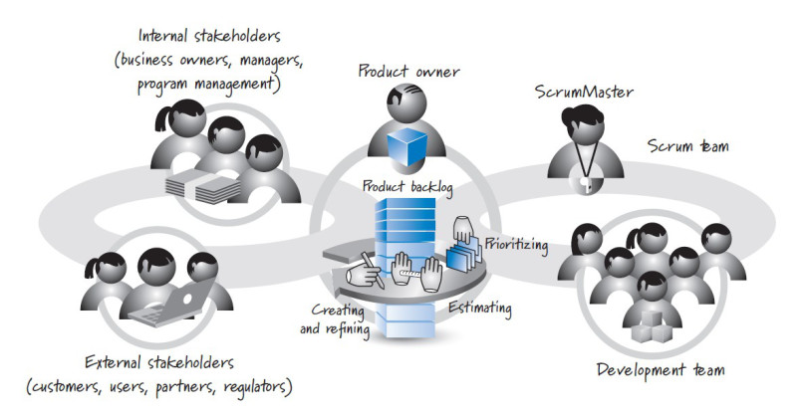
Iteration 5 – Stakeholder & Product Owner
Notes:
Visualization of how various teams are integrated

Slide 38
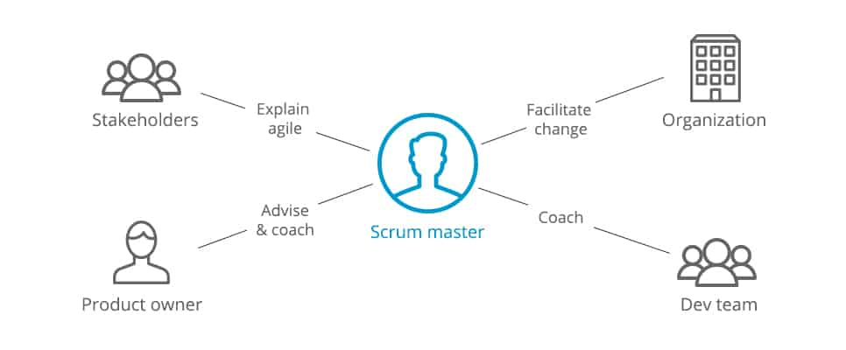
Iteration 5 – Scrum Master Managing External Groups
Notes:
How does the Scrum Master fit into managing External Teams? Stopping the craziness!!

Slide 39
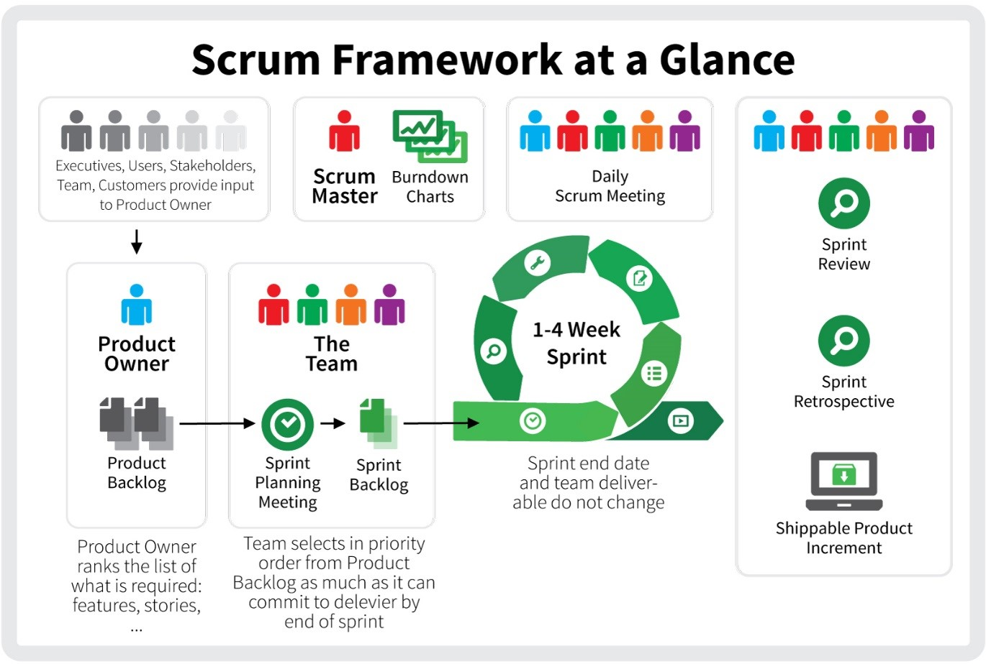
Agile Transformation End State
Notes:
Summary and overview of our ‘End State’, whilst remembering that there is never really an end state as we integrate ‘Continual Improvement’
Burn Down charts have not been covered, but are a frequent way for Scrum Masters and PM’s to visualise the completion of work and performance of teams

